Slide 1

Presentation 3: Design Proposal
Presented By: Brandon Knutson, Daniel Cooke, Isaiah Padilla, Mason Goodman, Mica Nellis, Russel Stringham

Slide 2
Project Description
Clients: Andrew Acosta & Arjun Banerji
Description:
Design a robotic drilling arm for Northrop Grumman Space Systems for vehicles that aid in sending satellites to orbit
Drill through composite materials to be able to bolt secondary structures such as brackets or tubing
Most importantly drilling through cylindrical structures that are used to connect entire vehicle together
Four Axis robotic drilling arm
  Axis 1: Base axis of the robot allowing for movement left to right
  Axis 2: Allows robotic arm to move forward and backwards from its center controlling the lower half
  Axis 3: Provides robots the ability to move in the x, y, and z controlling upper arm allowing for vertical reach
  Axis 4: End-effector location allowing “wrist” to rotate
Importance:
More efficient for Northrop Grumman
Able to manufacture “in house”
Saves time and money in regards to various tests to be performed
[1]

Slide 3
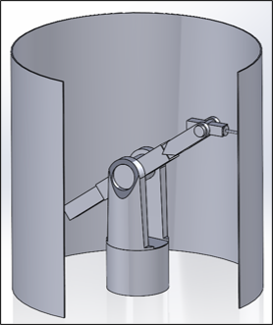
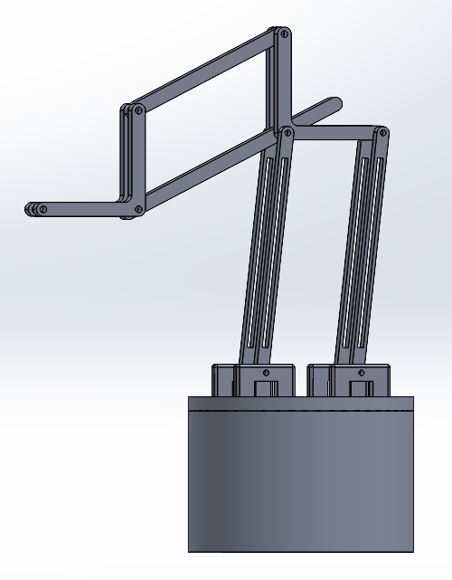
Design Description: Functionality
3 Motors
Linear Actuators
Rotating Base
Bad Tolerancing
3 Motors
No Linear Actuators
Parallel Beams
Rotating Base
Drill perpendicular to cylinder
Notes:
Provide a high-quality top-level and labeled drawing views of your design identifying major sub-systems. Use Solidworks/Onshape balloons and leader-line notes for this identification.
• Also provide a bullet list describing how your top-level design functions.
• Also provide a bullet list describing how each sub-systems function.

Slide 4
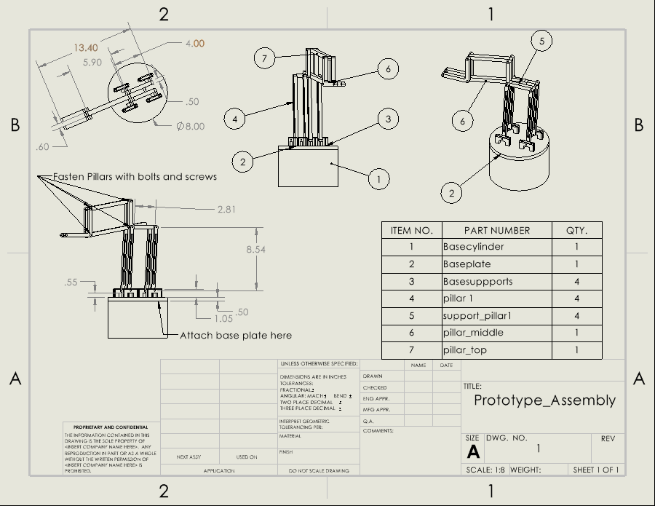
Design Description: Assembly Drawing

Slide 5
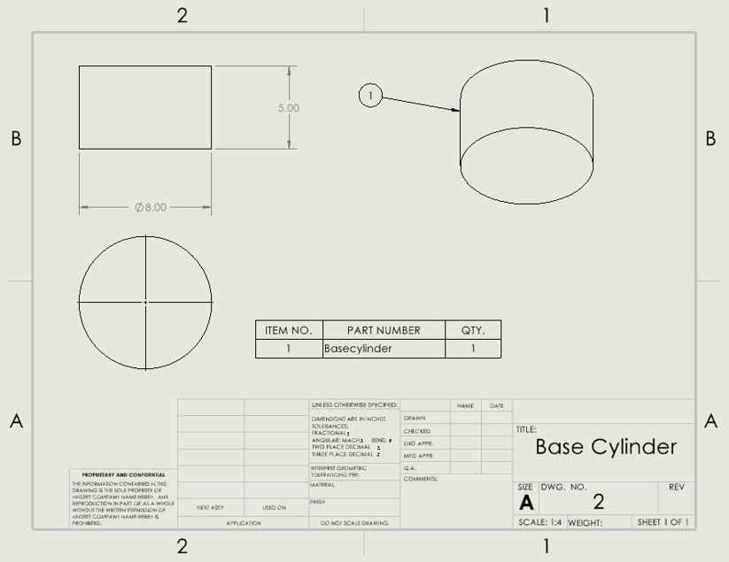
Design Description: Part Drawings

Slide 6
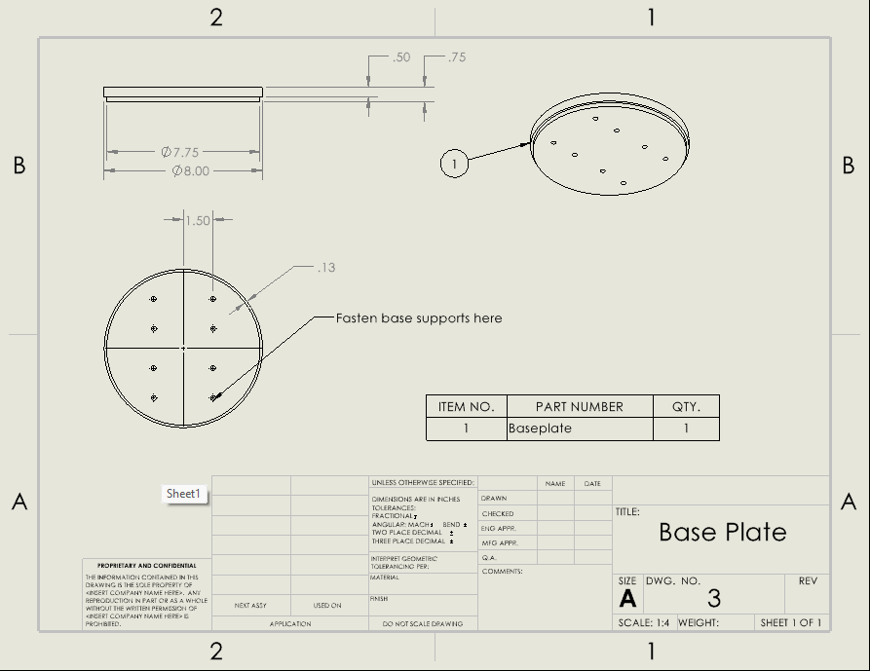
Design Description: Part Drawings

Slide 7
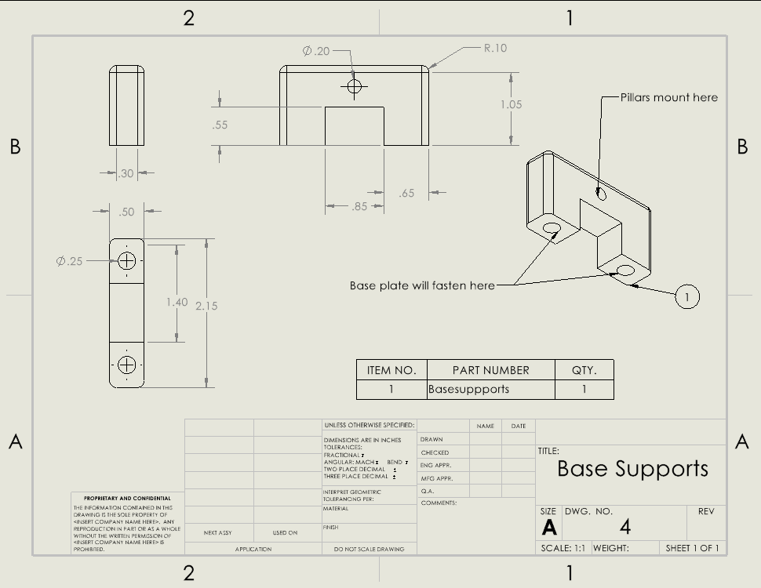
Design Description: Part Drawings

Slide 8
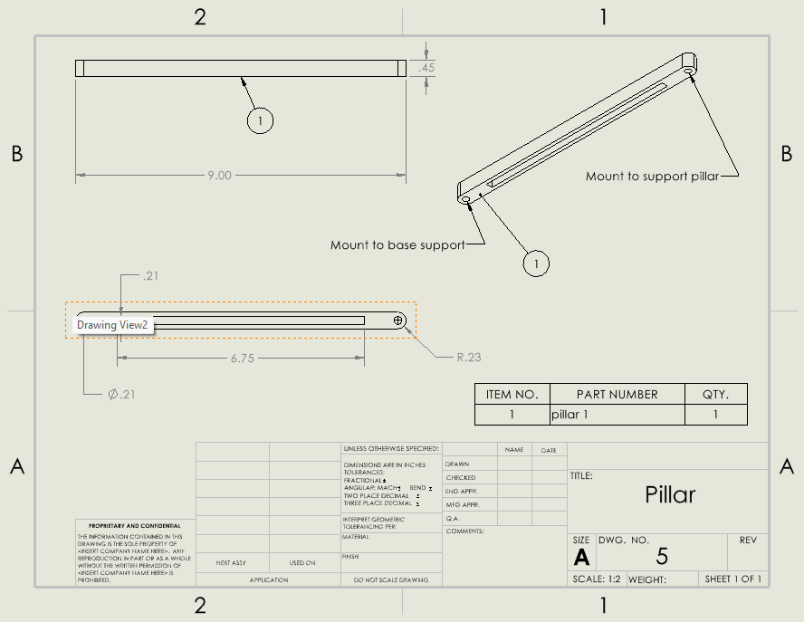
Design Description: Part Drawings

Slide 9
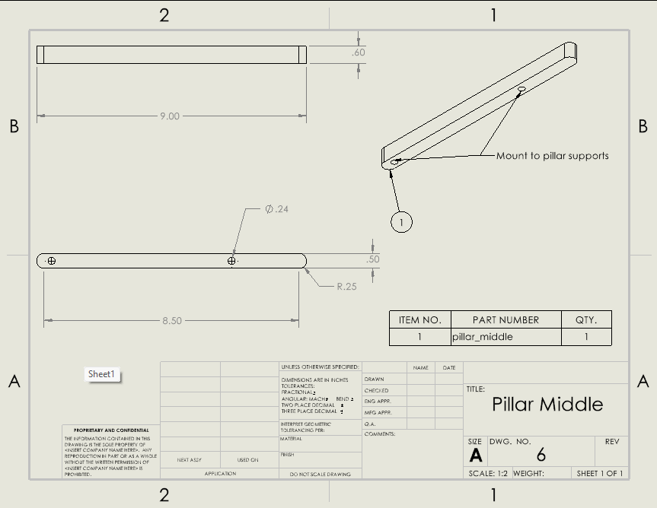
Design Description: Part Drawings

Slide 10
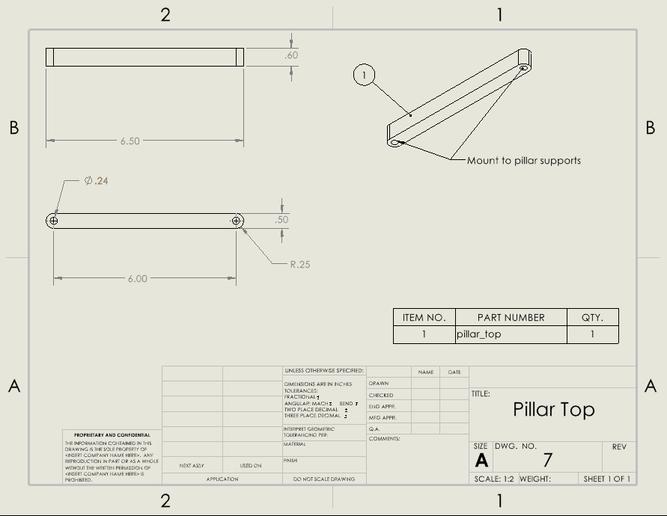
Design Description: Part Drawings

Slide 11
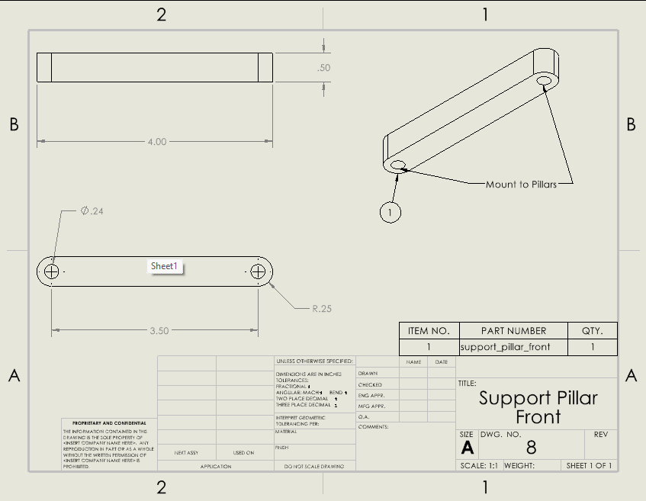
Design Description: Part Drawings

Slide 12
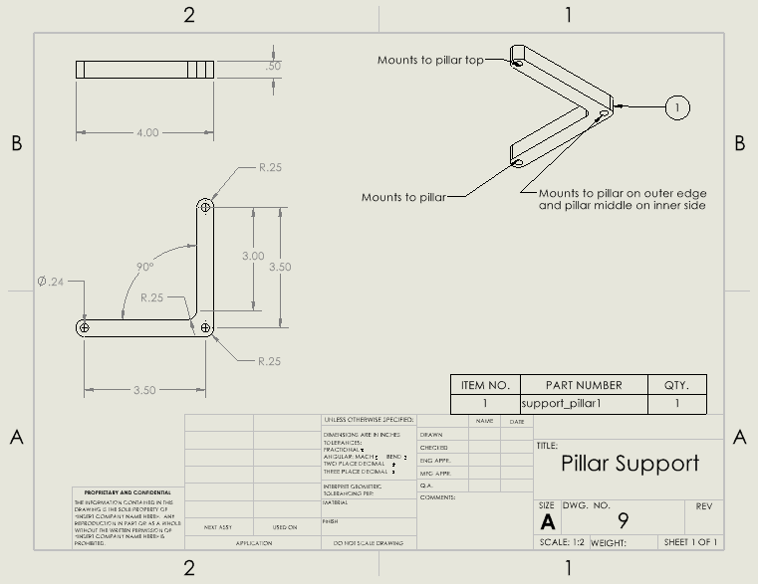
Design Description: Part Drawings

Slide 13
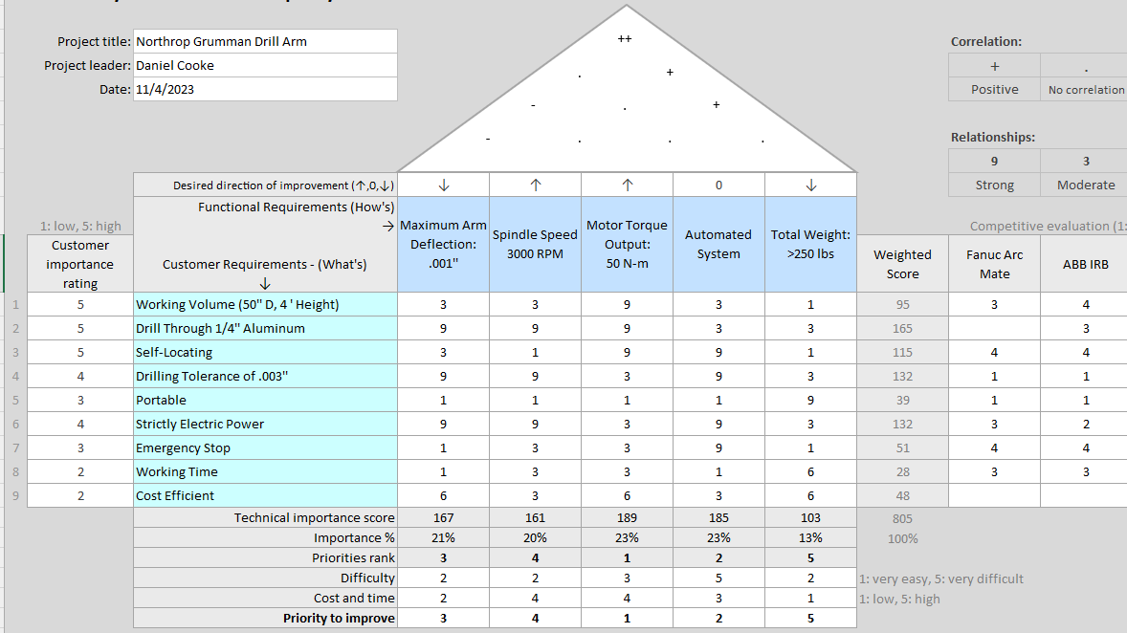
Design Requirements: QFD

Slide 14
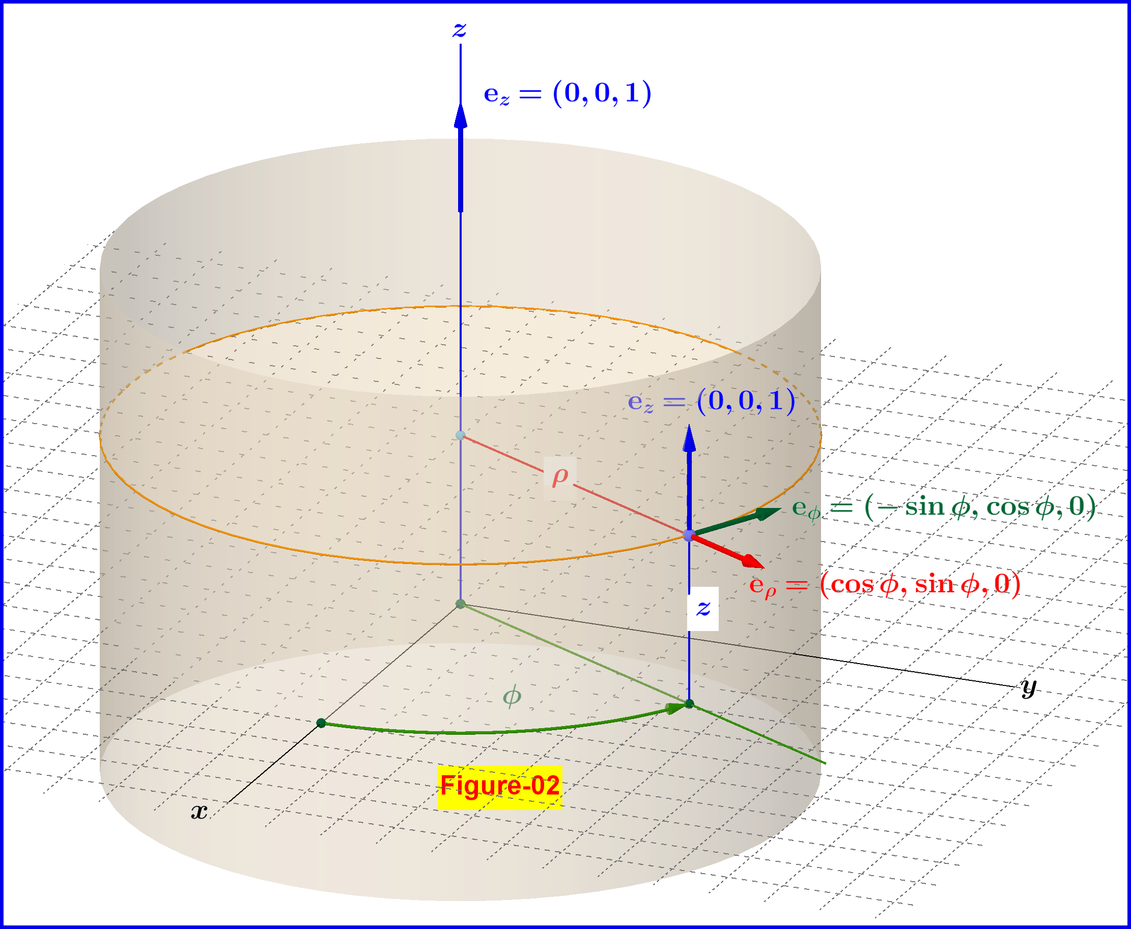
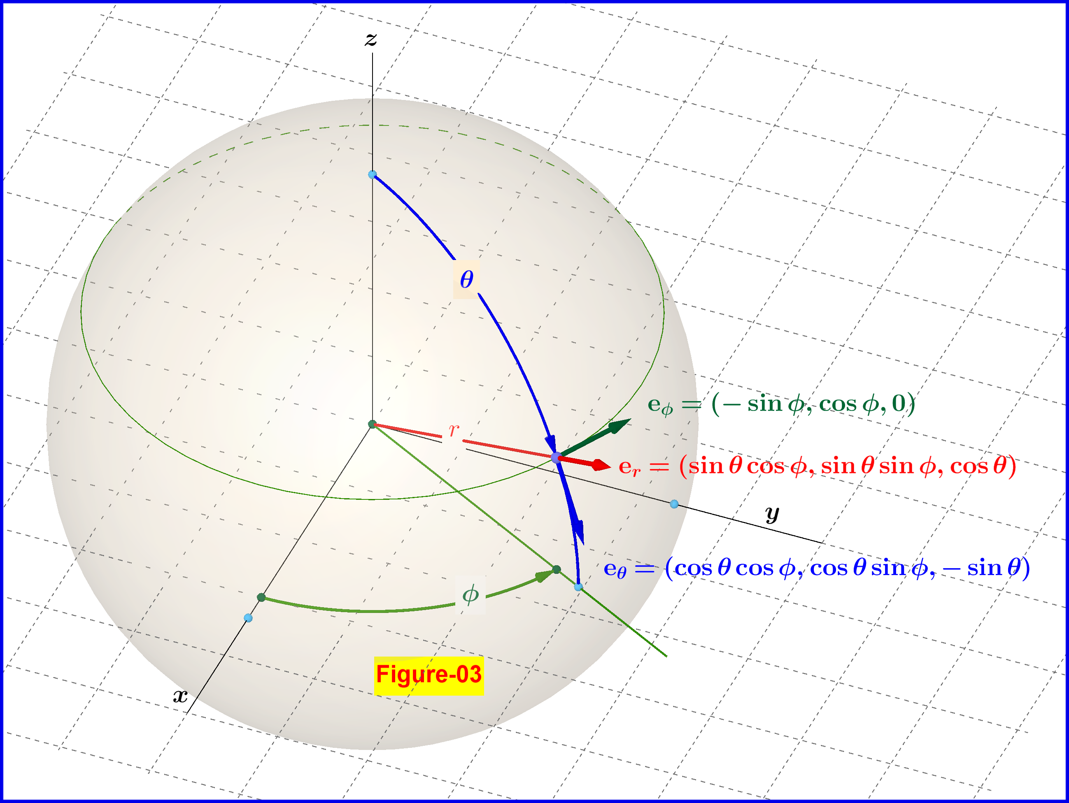
Movement Design: (Brandon)

Slide 15
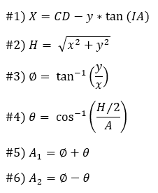
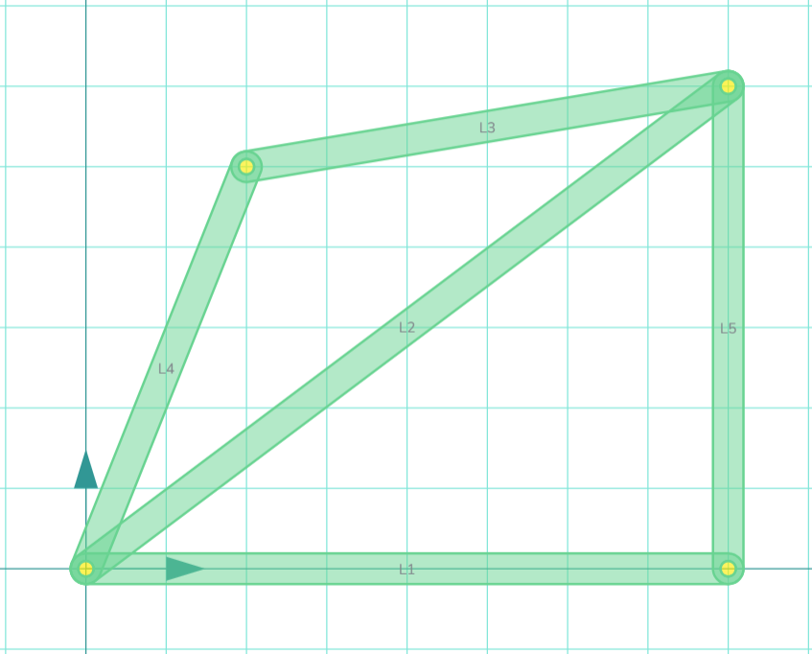
Reverse Kinematics
Input Hole Position and Cylinder Dimensions
Use #1 to calculate X position
Use # 2 and 3 to calculate Reach (H) and Phi
Use #4 to find Theta
Use #5 and 6 to find angular position of motors

Slide 16
Order Restructuring
Start position is known
Using a double nested loop function
Find the difference in angle between start position and all drill hole positions
Find smallest combined difference
Reorder list and repeat moving from hole to hole
Combinational Organization

Slide 17
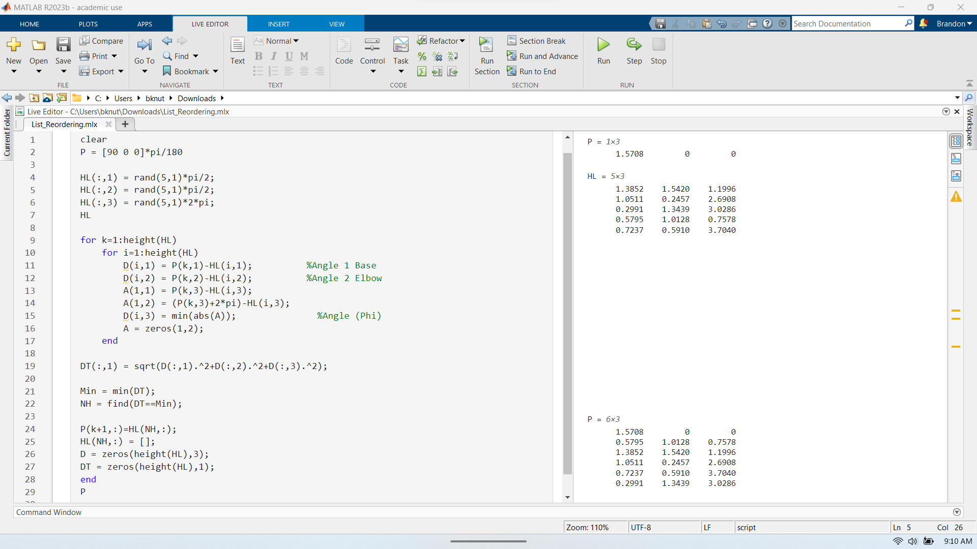

Slide 18
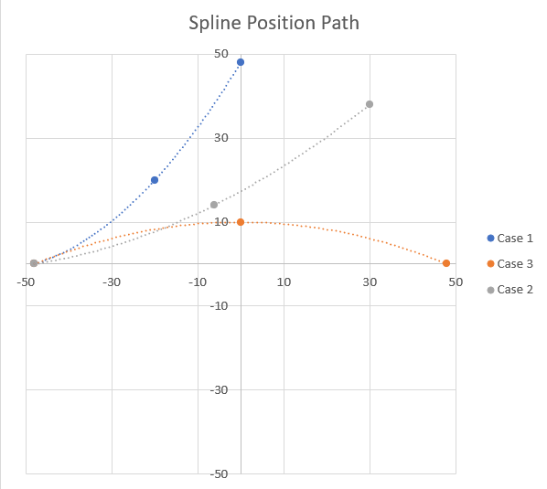
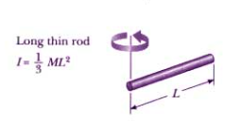
Cubic Spline Movement
T = IA
Torque = Moment of Inertia X Angular Acceleration
Case 1: 2.88 Times Greater
Case 2: 9.83 Times Greater
Case 3: 23 Times Greater
[4-7]
Brandon Knutson, 11/7/23, F23toSp24_NorthrupGrumman

Slide 19
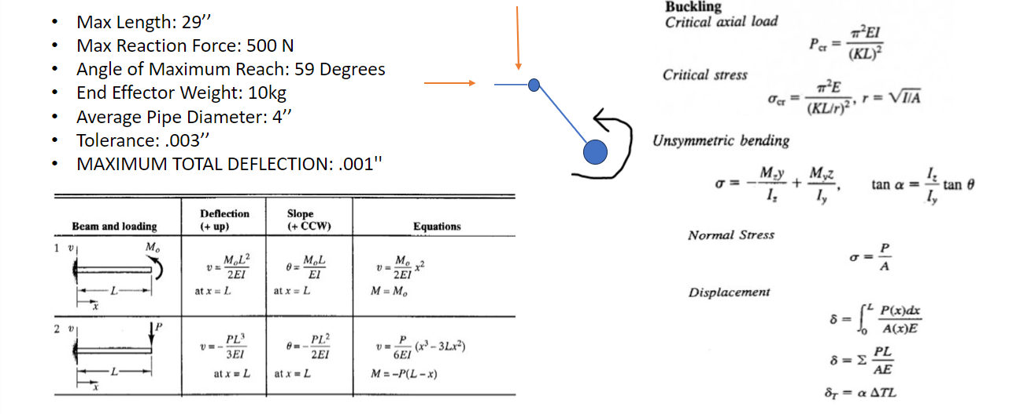
Engineering Calculations: Deflection

Slide 20
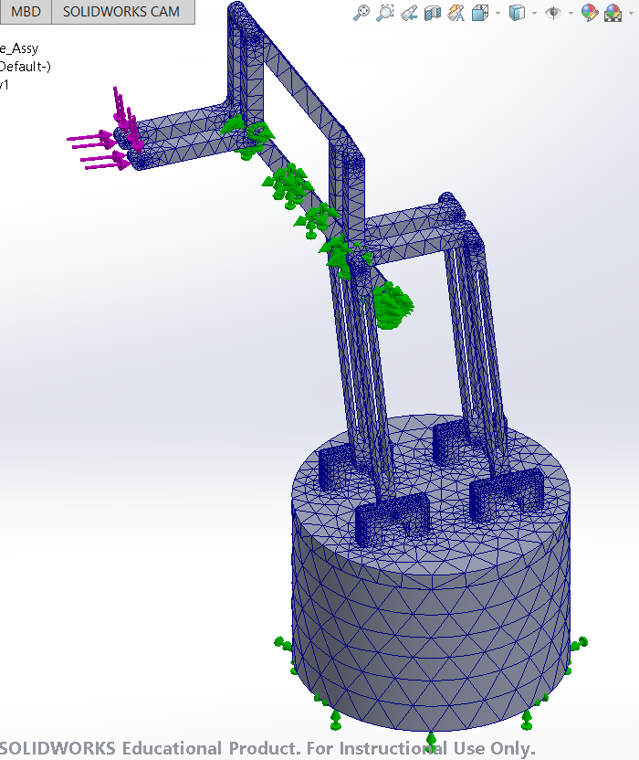
Engineering Calculations: Deflection
Material | Max Stress | Max Strain | Max Displacement
Steel Alloy | 7.821 E 07 N/m^2 | 1.935 E -04 | 9.22 E -06 m
AISI 4130 Steel | 7.821 E 07 N/m^2 | 2.271 E -04 | 1.05 E -05 m
6061-T6 Aluminum | 7.821 E 08 N/m^2 | 8.46 E -04 | 3.745 E -05 m
Highest Strain Member: Pillar 1
Redesign: Scale Cross Sections and Dimensions for Final Design
Final Material Selection: Aluminum (80/20 modular components)
Light Weight
Low Relative Cost
Easy Access and Machinability

Slide 21
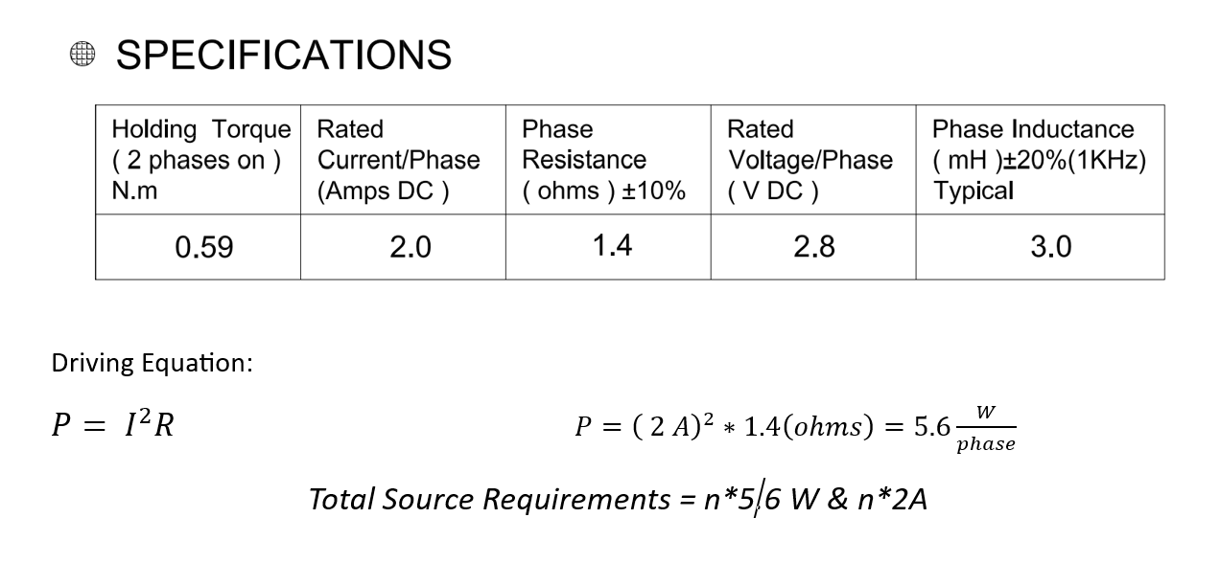
Engineering Calculations: Power Supply
Stepper Motor Phases
Electromagnetic Stator – Orientation
How Stepper Motor Design Power Needs
False Assumptions

Slide 22
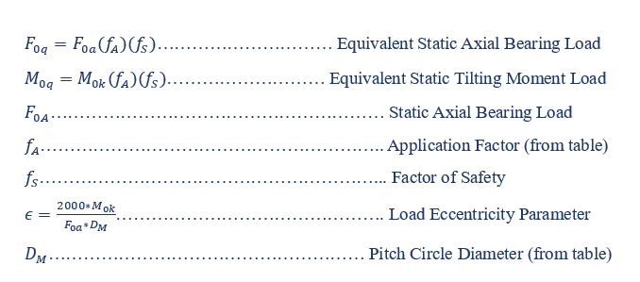
Engineering Calculations: Slewing Bearings & Rings
Factor of safety and application factors can be found in many resources including Shigley's Mechanical Engineering Design
Static axial bearing load as well as static moment load can be found within tables online choosing a proper value related to the team's bearing choice
[2]

Slide 23
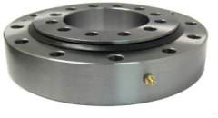
Engineering Calculations: Slewing Bearings & Rings
Specifications:
Four-point contact slewing ring
Bore: 120-357 mm
Outer Diameter: 280-543mm
Overall Width: 60-70 mm
Static Axial Load: 37,518-104,805 kg
Static Radial Load: 12,438-34,969 kg
Moment Load: 183,673-1.17E6 kg-cm
Lubrication: NLGI #2 Grease
[3]

Slide 24
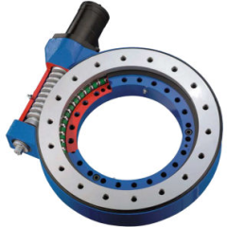
Engineering Calculations: Slewing Bearings & Rings
Specifications:
Single Row ball bearing
For heavy load applications
Bore: 145.01-524.99 mm
Outside Diameter: 351-781 mm
Overall Width: 81.99-130 mm
Static Axial Load: 55,329-240,816 kg
Static Radial Load: 20,408-89,796 kg
External gear only
[3]

Slide 25
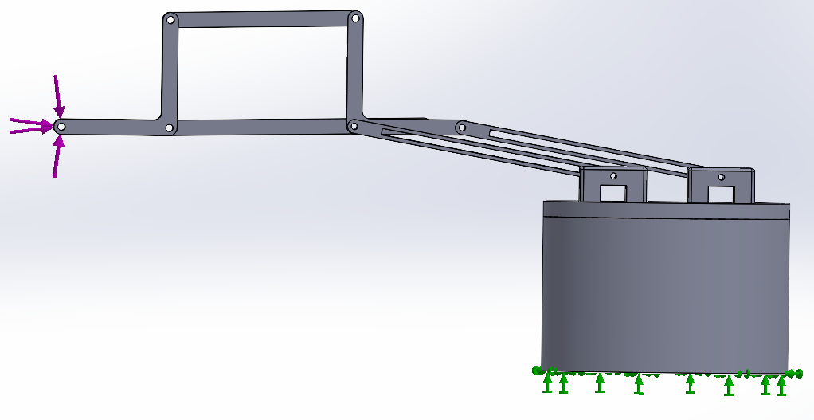
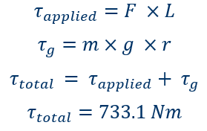
Engineering Calculations: Holding Torque
Gravity
Holding Torque at Full Extension:
Force Applied: 25 N
Fixed Point
Weight of arm (m): 25 kg (245.17 N)
Length of arm (L): 0.7366 m (2.42 ft)
Distance to center of mass (r): 0.3048 m (1 ft)
Gravity (g): 9.81 m/s^2

Slide 26
Design Validation
Critical Failure Points
Failure Modes
Power Outage: System Will Fall
Power Bank or Additive Breaking
Linkage Deflection and Fracture
Linkage Inspection and Factor of Safety
Spindle Failure
Auditory and Cutting Force Sensors
Interference
Self-stop controlled by motor exertion
Bearing Failure
Audible Noise and Siezing
Self-stop controlled by motor exertion
Bolt Shear
Inspection, Factor of Safety, and Emergency Stop
[8-10]

Slide 27
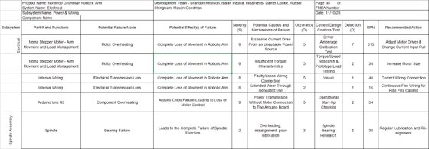
FMEA

Slide 28
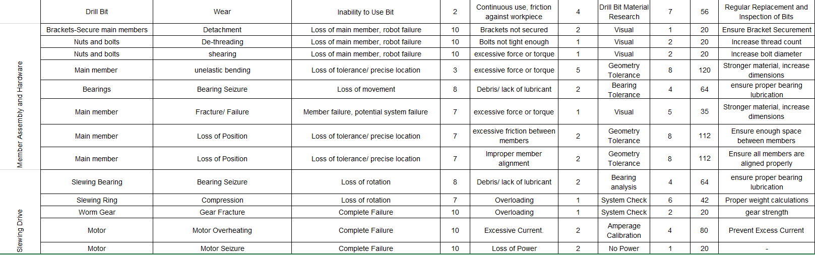
FMEA

Slide 29
Design Validation
Design Testing
Testing Resources
Secure Room with Wall Power
Fabricated Design
Computer with Input Commands
Emergency Shut Off Button
PPE: Safety Googles
Table or Plexiglass Shield
Experiments to Run
Power Outage Test
Excessive Movement
Intentional Damaging
Interference when Operating

Slide 30
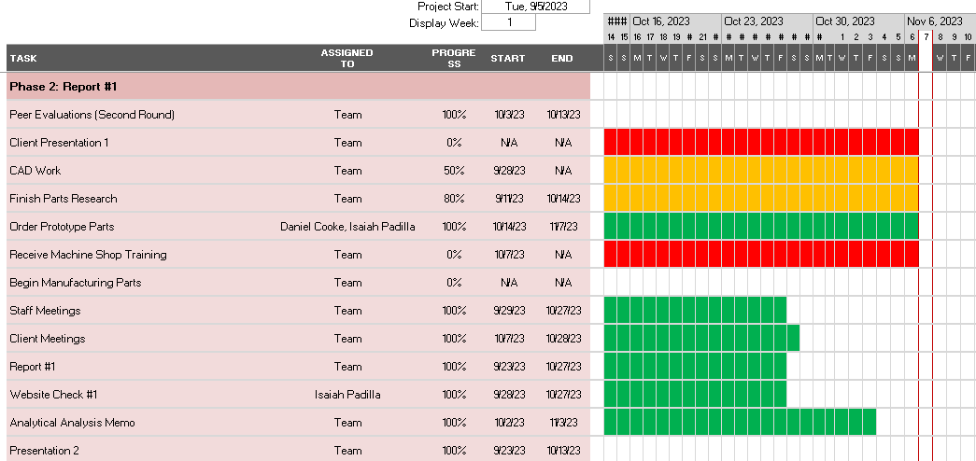
Schedule
Update for previous phase of tasking

Slide 31
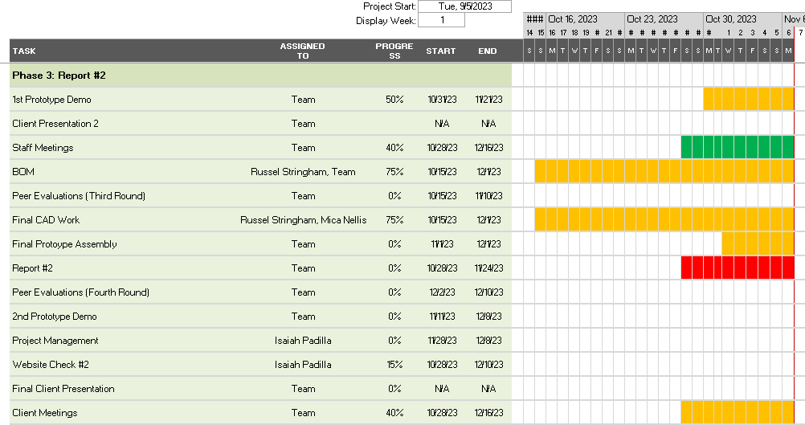
Schedule
Team is behind on tasks, but is catching up at an acceptable rate

Slide 32
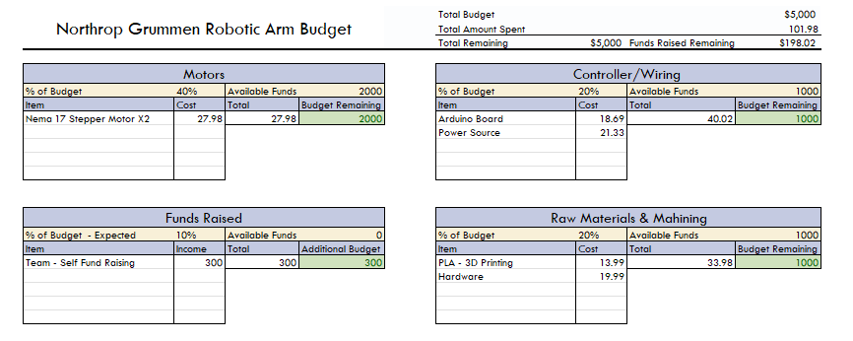
Budget

Slide 33
Questions?

Slide 34
Resources
[1]“What is a Four-Axis Robot?” https://robotsdoneright.com/Articles/what-is-a-four-axis-robot.html#:~:text=parts%20more%20accessible.-,%E2%80%A2,is%20able%20to%20rotate%20parts.
[2] Slewing Rings, Catalog 404. Schaeffler Technologies AG & Co. KG, 2012.
[3] “DatasheetDirectory,”Globalspec.com,2020.https://www.globalspec.com/specsearch/partspecs?partId=
[4]“Moment of Inertia - Formulas, MOI of Objects [Solved Examples],” BYJUS. https://byjus.com/jee/moment-of-inertia/
‌[5] “Relation Between Torque And Moment Of Inertia - BYJU’S,” BYJUS. https://byjus.com/physics/relation-between-torque-and-moment-of-inertia/
‌[6] “Cubic spline interpolation with end conditions - MATLAB csape,” www.mathworks.com. https://www.mathworks.com/help/curvefit/csape.html (accessed Nov. 07, 2023).
‌[7] “Slug (unit),” Wikipedia, Feb. 17, 2021. https://en.wikipedia.org/wiki/Slug_(unit)
‌[8] Z. Xiao, H. Ma, Y. Lu, G. Zhang, Z. Liu, and Q. Song, “Real-Time milling tool breakage monitoring based on multiscale standard deviation diversity entropy,” International Journal of Mechanical Sciences, vol. 240, p. 107929, Feb. 2023, doi: https://doi.org/10.1016/j.ijmecsci.2022.107929.
‌[9] “40 Series (40mm Based Profiles) | Metric | T-Slotted Profiles | Framing Options,” 8020.net. https://8020.net/framing-options/t-slotted-profiles/metric/40series40mmbasedprofiles.html (accessed Nov. 07, 2023).
‌[10] “5 Causes of Motor Failure and How to Prevent Them,” www.acorn-ind.co.uk, May 16, 2018. https://www.acorn-ind.co.uk/insight/five-causes-of-motor-failure/
‌

